Slide 1
7.1.6: Bit-Trees
Presented by Dr Anna Bosman

Slide 2
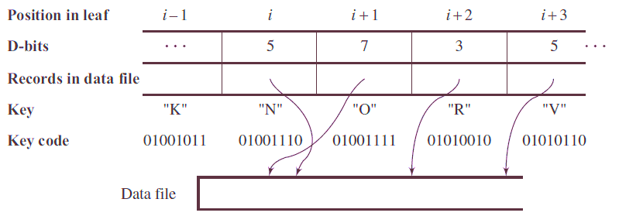
Bit-trees
Simple prefix B+-trees improved B+-trees by compressing the keys to prefixes
What is the limit of such compression?
All data stored on a computer is encoded in binary
Bit-level difference can be used to distinguish between keys
Bit-trees were introduced by E. Ferguson in 1992
  A prefix B+-tree is used to store the index set
  Leaves, however, store distinction bits instead of the keys themselves
  The keys and the corresponding data is stored in a data file referenced by the leaf node
  This way, a single
  leaf can
  accommodate
  more information
  Algorithm for
  searching a leaf for
  a specific key is
  bit-level efficient

Slide 3
Bit-trees
Distinction bit (D-bit): the most significant (leftmost) bit that differs two bit strings X and Y
D(X,Y) – index of the D-bit for X and Y
Example:
What is D(X,Y)?
  3
What is D(Y,Z)?
  1
What is D(X,Z)?
  1
0 | 1 | 2 | 3 | 4
X | 0 | 0 | 1 | 0 | 1
Y | 0 | 0 | 1 | 1 | 0
Z | 0 | 1 | 0 | 0 | 0

Slide 4

Bit-trees
Storing 2 3 5 6 8 in a bit-tree leaf:
Important properties of D-bits:
  Keys are stored in ascending order: $key_{i−1}<key_{i}$;
  Thus, the $D_{i}$ bit in$key_{i}$ will always be 1, not 0
  For $i<j, D_{j}$ bit will be 1 for all following j, as long as ${D_{i}<D}_{j}$
    Why: because if ${D_{i}<D}_{j}$, least significant bits change;
    ${D_{i}>D}_{j}$ is a signal of the change in most significant bit.
0 | 1 | 2 | 3 | 4
n/a | 3 | 1 | 2 | 0
ptr0 | ptr1 | ptr2 | ptr3 | ptr4
D-bits
Data pointers
2 | 3 | 5 | 6 | 8
0010 | 0011 | 0101 | 0110 | 1000
keys
keys in binary
2: 0010 (n)
3: 0011 (3)
5: 0101 (1)
6: 0110 (2)
8: 1000 (0)

Slide 5
How do you search a Bit-Tree?
Assume you’ve already found the correct leaf using Prefix B+-tree search.
Goal: find the correct pointer in the leaf.
Given: binary key to look for.
All we need to do is find the location in the bit-tree leaf that matches the most bits
What do we know about the keys associated with D-bits?
D-bit: | 0 | 1 | 2 | 3
1
2
0
1
X
X
0
0
X
X
1
1
1
X
X
X
0
X
X
X
X
0
1
X
X
X
1
X
1
X

Slide 6
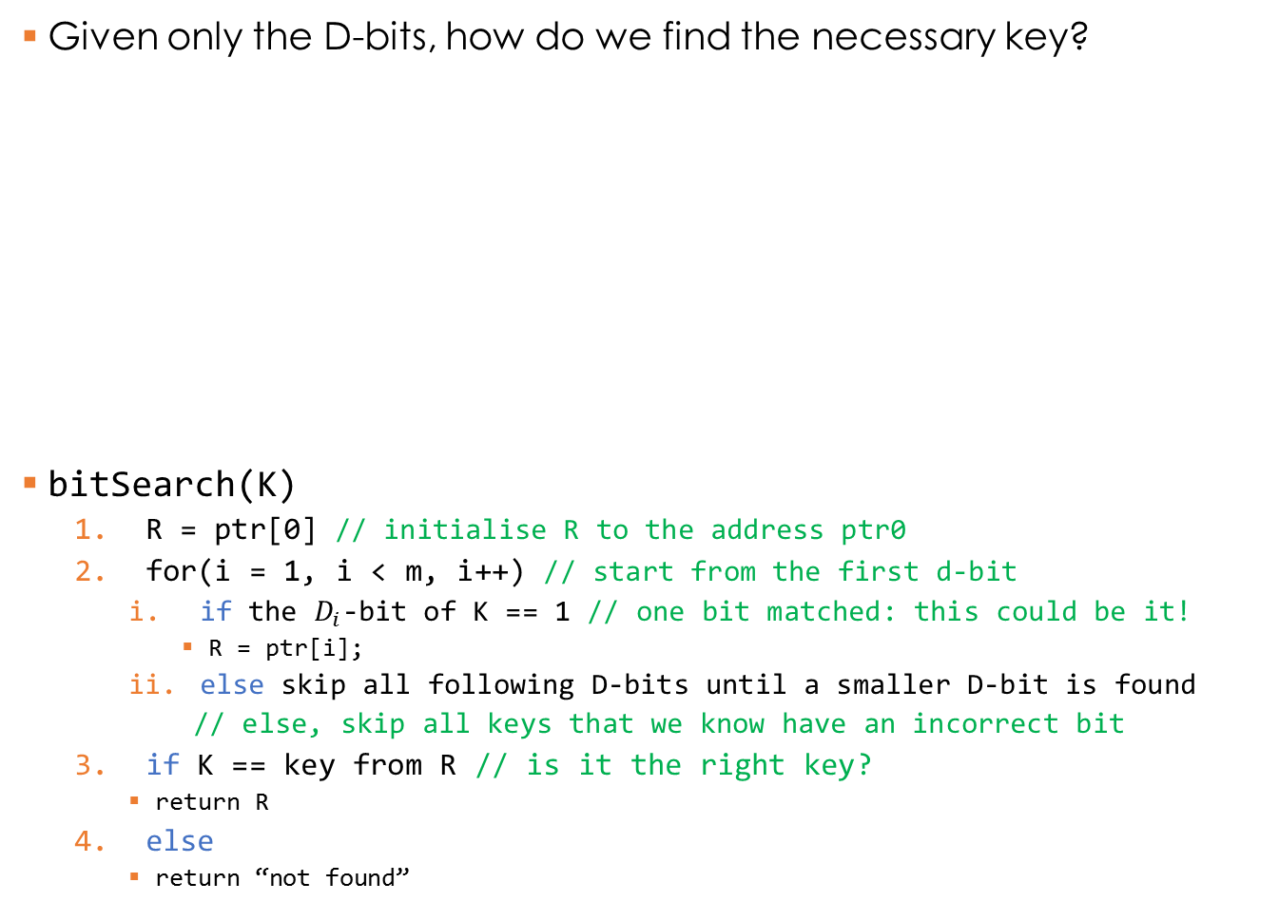
Bit-trees
Given only the D-bits, how do we find the necessary key?
bitSearch(K)
  R = ptr[0] // initialise R to the address ptr0
  for(i = 1, i < m, i++) // start from the first d-bit
    if the $D_{i}$-bit of K == 1 // one bit matched: this could be it!
      R = ptr[i];
    else skip all following D-bits until a smaller D-bit is found
    // else, skip all keys that we know have an incorrect bit
  if K == key from R // is it the right key?
    return R
  else
    return “not found”
0 | 1 | 2 | 3 | 4
n/a | 3 | 1 | 2 | 0
ptr0 | ptr1 | ptr2 | ptr3 | ptr4
D-bits
Data pointers
2 | 3 | 5 | 6 | 8
0010 | 0011 | 0101 | 0110 | 1000
keys
keys in binary

Slide 7

Bit-trees
bitSearch(K)
  R = ptr[0]
  for(i = 1, i < m, i++)
    if the $D_{i}$-bit of K == 1
      R = ptr[i];
    else skip all following D-bits until
    a smaller D-bit is found
  if K == key from R
    return R
  else
    return “not found”
Search for 6 (0110):
Set R = ptr[0]
Always start at i = 1
i=1: 3rd bit of 6 != 1
i=2: 1st bit of 6 == 1
  R = ptr[2]
i=3: 2nd bit of 6 == 1
  R = ptr[3]
i=4: 0th bit of 6 != 1
Done with for loop! Is R.key == 6?
Yes – return R
0 | 1 | 2 | 3 | 4
n/a | 3 | 1 | 2 | 0
ptr0 | ptr1 | ptr2 | ptr3 | ptr4
2 | 3 | 5 | 6 | 8
0010 | 0011 | 0101 | 0110 | 1000

Slide 8
Bit-trees
bitSearch(K)
  R = ptr[0]
  for(i = 1, i < m, i++)
    if the $D_{i}$-bit of K == 1
      R = ptr[i];
    else skip all following D-bits until
    a smaller D-bit is found
  if K == key from R
    return R
  else
    return “not found”
Search for 8 (1000):
Set R = ptr[0]
Start at i = 1
i=1: 3rd bit of 8 != 1
i=2: 1st bit of 8 != 1
  Skip to i == 4
i=4: 0th bit of 8 == 1
  R = ptr[4]
Done with for loop! Is R.key == 8?
Yes – return R
0 | 1 | 2 | 3 | 4
n/a | 3 | 1 | 2 | 0
ptr0 | ptr1 | ptr2 | ptr3 | ptr4
2 | 3 | 5 | 6 | 8
0010 | 0011 | 0101 | 0110 | 1000

Slide 9
Bit-trees
bitSearch(K)
  R = ptr[0]
  for(i = 1, i < m, i++)
    if the $D_{i}$-bit of K == 1
      R = ptr[i];
    else skip all following D-bits until
    a smaller D-bit is found
  if K == key from R
    return R
  else
    return “not found”
Search for 0 (0000):
Set R = ptr[0]
Start at i = 1
i=1: 3rd bit of 0 != 1
i=2: 1st bit of 0 != 1
  Skip to i == 4
i=4: 0th bit of 0 != 1
Done with for loop! Is R.key == 0?
No – return “not found”
0 | 1 | 2 | 3 | 4
n/a | 3 | 1 | 2 | 0
ptr0 | ptr1 | ptr2 | ptr3 | ptr4
2 | 3 | 5 | 6 | 8
0010 | 0011 | 0101 | 0110 | 1000
What if we were searching for
2 (0010)?

